Slide 1
TEST 1

Slide 2
Welcome to Our Presentation
Let’s Begin Now!
Company A sells fashion. They have stores in each country’s capital: UK (London); FR (Paris); IT (Milan); GER (Berlin). Their customers either buy online or in the store itself.
At the same time, it maintains a website of individual product pages with write ups and images about the page. In some cases, the page might have gone up after the product was put up for sale.
Management would like you – the data analyst – to use of this data and answer these questions:
What is the impact of our website traffic on revenue?
Which products get us pageviews and revenue?
What customer segments are there?

Slide 3

1
INTRODUCTION

Slide 4
We Are
Super Awesome.
HELLO!

Slide 5
Table of
Contents
Introduction
Before starting our presentation
About This Dataset
What we do
Web Traffic
What is the impact of our website traffic on revenue?
Product
Which products get us pageviews and revenue?
Customer Segmentation
What customer segments are there?
Question
Keep it touch!

Slide 6

2
ABOUT DATASET

Slide 7
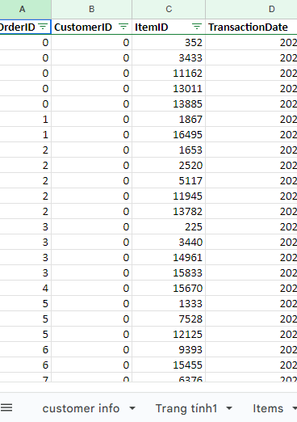
About Dataset
Data Sources
Source | Description | Link
Customers & Transactions | Customer info and their transactions. These transactions are a mix of in-store and online transactions. | Customers
Website Traffic | Website traffic data for individual product pages (Duration: Jan to Dec 2020) | Traffic

Slide 8
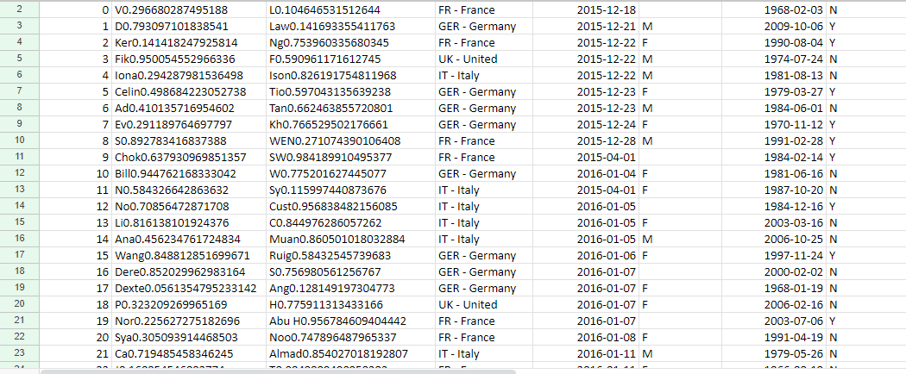
About Dataset
Data Sources
Customer Info

Slide 9
Customer (UK):
CustomerInfo:
ID : customer id
FirstName
LastName
Country
DateJoined
Gender
Birthday
Newsletter
CustomerTransaction
OrderID:
CustomerID
ItemID
TransactionDate
Channel
Items:
ItemID
Product
Brand
SellPrice
CostPrice
Traffic:
Page URL
users
uniquePageviews
pageviews
Brand
Posted On

Slide 10

3
WEBSITE TRAFFIC

Slide 11
[Profit] = [Price] - [Cost]
=> Revenue

Slide 12
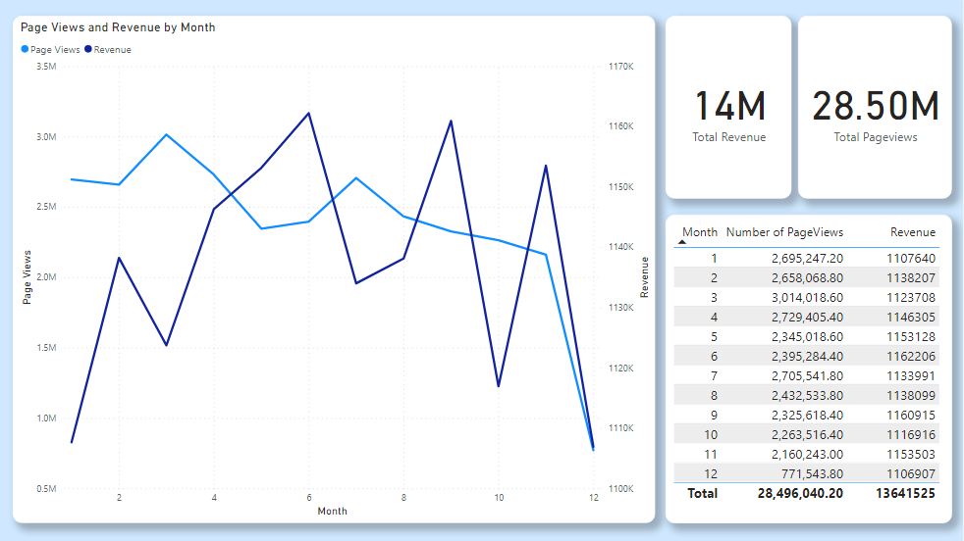

Slide 13

4
PRODUCT

Slide 14
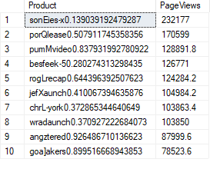
Which products get us pageviews and revenue?
TOP 10 Products get the most pageviews.

Slide 15
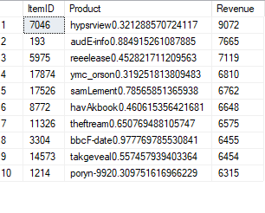
Which products get us pageviews and revenue?
TOP 10 Products get the most revenue.

Slide 16

5
CUSTOMER
SEGMENTATION

Slide 17
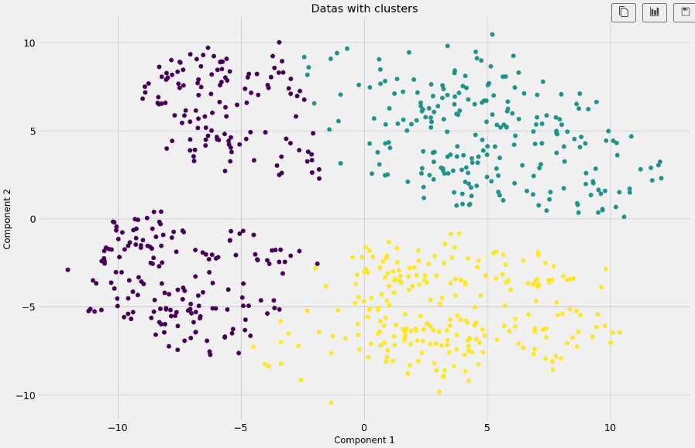

Slide 18
Life can only be understood backwards; but it must be lived forwards.

Slide 19
Thank You for Watching!
Any Questions?
Jun Akizaki - http://thepopp.com
Used Font: Route 159 Family & Open Sans Family
Icon: Font Awesome, the author is Dave Gandy (Changed the color by Photoshop)
Typicons, the author is Stephen Hutchings (Changed the color by Photoshop)

